Slide 1





Slide 2


Questions
1
Which movies created the most revenue?
2
What was the average rental duration for all videos?
3
Which countries are Rockbuster customers based in?
4
Where are customers with a high lifetime value based?
Do sales figures vary between geographic regions?
5

Slide 3


Product Initiatives
Use existing movie licenses to launch an online video rental service that will be branded as Rockbuster Stealth
Online video rental service should strengthen the company's competitive advantage in these times of heightened competition from Amazon, Netflix & Hulu

Slide 4




Analysis
Details of legacy Rockbuster business:
Max Rental Duration: 7 Days
Average Rental Duration: 5 Days
Minimum Rental Rate: $0.99
Maximum Rental Rate: $4.99
Average Rental Rate: $2.98
Details compiled to help gauge pricing for Rockbuster Stealth:
Average Revenue from Movie: $64
Average Customer Spend: $102.53 yearly $8.55 monthly
Highest Revenue per Movie Rating: PG-13 with 23% of total revenue
Highest Revenue per Genre: Sports with 8% of total revenue
Highest Grossing Country: India
Country with largest customer base: India (60 customers)
Top Customer resides in India
Total Spend from Top Customer $111.76

Slide 5
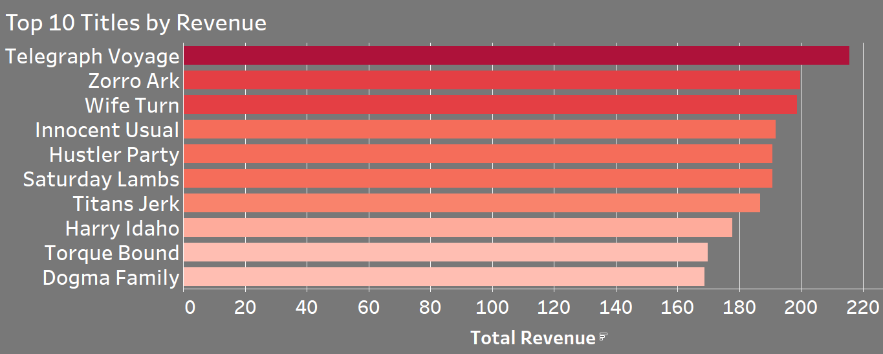
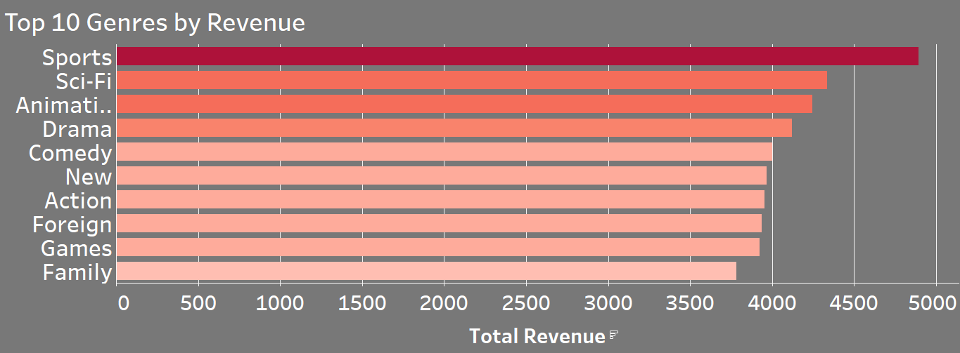

Sports is the largest revenue producing genre comprising 8% of total market share in terms of revenue globally.
The top ten titles by revenue command 3% of global sales.
Based on this information we believe Rockbuster should update the top ten list of movies daily on the new Rockbuster stealth streaming service to constantly drive demand to the new ecosystem.
Rockbuster should focus a slightly larger number of resources on the Sports genre since it alone compiles 8% of global sales.
Outside of the sports genre the percentage of sales is similar, and resources should be spread evenly so we can reach the largest amount of the addressable market.

Slide 6
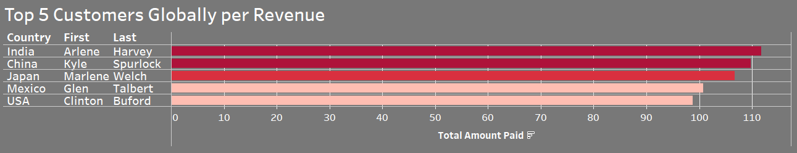
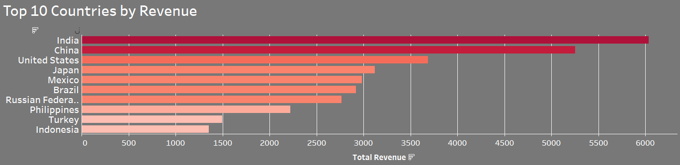
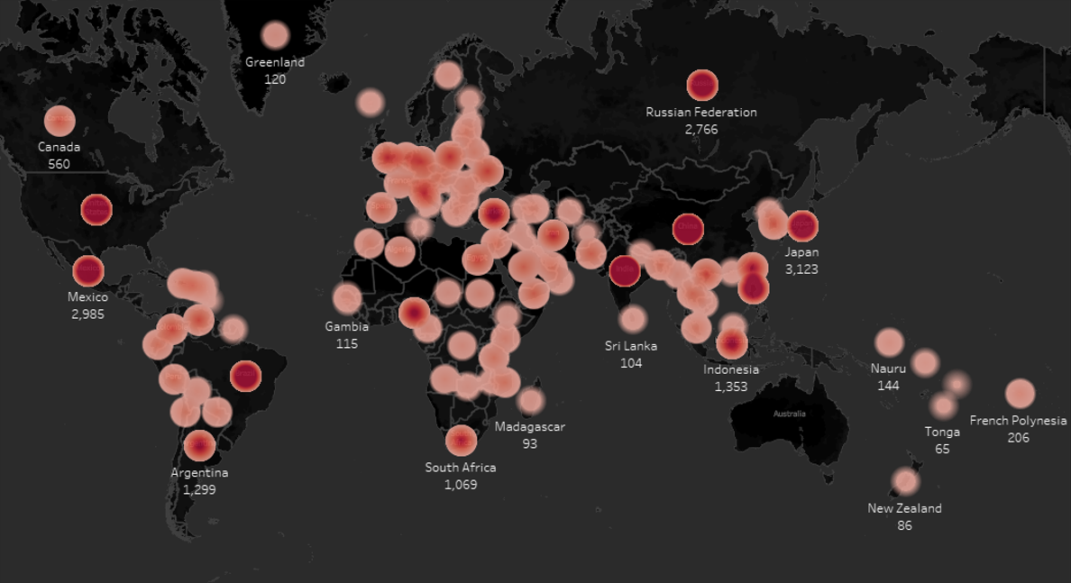
Total Revenue Per Country:
We find the top 5 customers living in the top five countries in terms of revenues. We should focus resources in those markets where are customer number is high as well as overall revenues.
Also, countries like India and China have larger GDP growth with larger population growth. We should take this into consideration when allocating resources.

Slide 7


Strategy
Subscription plan:
Standard plan of $9.99
Premium Plan of $13.99
Increase spending in largest revenue silos:
PG-13 Rated Movies
Movies within Sports Genre
India, China, & South America
Create Loyalty Program to retain customers in top markets like:
India, China, USA, Japan, Mexico

Slide 8



